Slide 1
Importance of Evidence
Hantong Hu, Qin Li, Jiawen Liu, and Emily Voldal
Notes:
This is a meta-analysis on community wide interventions for increasing physical activity, we are curious about how the ability of the intervention to improve physical activity level in a population.

Slide 2
Importance of physical activity
Physical inactivity remains a concerning public health topic
Lack of physical activity leads to poor health
Regular physical activity helps reduce chronic diseases
Improve health conditions and well-being
Source: Baker PRA, Francis DP, Soares J, Weightman AL, Foster C. Community wide interventions for increasing physical activity. Cochrane Database of Systematic Reviews 2015, Issue 1. Art. No.: CD008366. DOI: 10.1002/14651858.CD008366.pub3.
Notes:
Despite many studies show positive health effect associated with regular physical activity, physical inactivity still remains a public health problems.

Slide 3
Objective
To determine the effects of community wide, multi-strategic interventions on community levels of physical activity
Why a review is warranted:
Few previous studies have published evaluations of their process or impact
Earlier reviews lack of recent studies and newer health promotion strategies
The Cochrane review combined a more in-depth, up-to-date exploration of the effectiveness of the interventions.
Notes:
Many studies of community wide interventions have been undertaken but, prior to our review, few have published evaluations of their process or impact.

Slide 4
Search for studies
All relevant studies released between 1995 and 2014, regardless of language or publication status
Databases and registries (e.g. Web of Science, MEDLINE)
Websites (e.g. CDC, HealthEvidence.org)
Reference lists of systematic reviews, guidelines, and primary studies
Contacted experts in the field
Identified 27,089 potentially relevant studies

Slide 5
Inclusion criteria
Examining a community wide intervention for physical activity
At least two broad strategies (e.g. social marketing, individual counselling)
Focused on the population as a whole
Community is geographically defined and not focused on particular subgroups
Variety of designs (but no randomising individuals from the same community)
Cluster randomised controlled
Randomised controlled
Quasi-experimental with a control population
Interrupted time-series
Prospective controlled cohort
At least six months intervention before measuring outcomes
Of the 27,089 studies examined, 33 met all inclusion criteria
Notes:
A total of 33 studies
25 in high income countries and 8 in low income.
19 with high risk of bias, 10 unclear, 4 with low risk.

Slide 6
Biases assessed
Selection bias: samples selected are not representative of the population
Performance bias: one group of subjects in an experiment gets more attention from investigators than another group
Attrition bias: different rates of loss-to-follow-up that changes the original characteristics of the study group
Detection bias: differences between groups in how outcomes are determined
Reporting bias: selective disclosure of information including the design, conduct, analysis, or results of a study

Slide 7
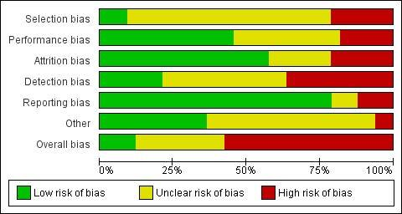
Summary of biases
3
26
4
19
Figure 3. Risk of bias graph: review authors' judgements about each risk of bias item presented as percentages across all included studies.

Slide 8
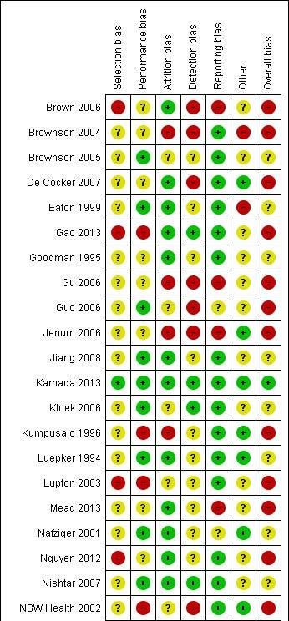
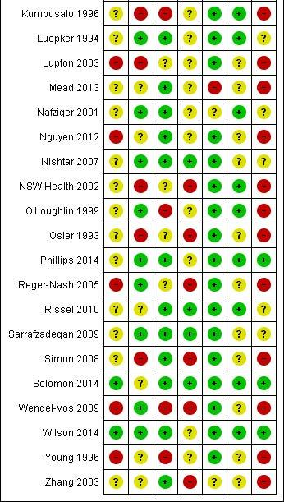
Which studies have low risk of bias?
Randomized intervention
What if intervention cannot be assigned randomly?
Valid and reliable measurement metrics for population level interventions
Avoid self-report
Individuals sampled should be representative of the population
Report all measures
Figure 4. Risk of bias summary: review authors' judgements about each risk of bias item for each included study.

Slide 9
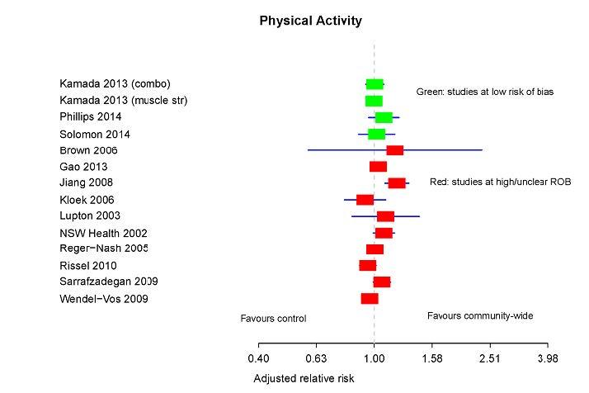
Results Summary
Studies using binary physical activity measure as outcome
% physically active, % physically active during leisure time, % physically inactive
Expressed as relative risk (RR) and risk difference (RD)
Calculated adjusted RR/RD for comparison (e.g. Fig. 5)
Studies using continuous physical activity measure as outcome
Leisure time physical activity time, walking time, energy expenditure
Calculated adjusted mean difference/percentage change
Not all study results are reliable!
Green bar: studies at low risk of bias
Red bar: studies at high/unclear bias
Summary of studies are on the next slide
Baker et al. (2015) Fig. 5

Slide 10
Table summary for all studies included
Report outcome | # of studies | # with evidence
Binary outcome
Physically active | 27 | 4 (2 in China, 1 in male and 1 in female)
Physically active during leisure time | 3 | 2
Physically inactive | 7 | 2 (1 found evidence in effectiveness and 1 found evidence of failure)
Continuous outcome
Leisure time physical activity by time | 3 | 3
Walking time | 4 | 2 (both in Missouri)
Energy expenditure | 5 | 2
Notes:
(27):
Some common standards: 150 min/week, 5 moderate activity/3 vigorous activity
2 studies in China found stat. Sig. effectiveness
1 found evidence in male and 1 found in female
Physically active during leisure time 3:
1 found inconsistent evidence
Physically inactive 7:
Leisure time physical activity by time 3:
Each showing some evidence of effectiveness
Walking 4:
2 in Missouri fond some effectiveness
Energy expenditure 5:
3 no evidence, 2 with evidence

Slide 11
Study conclusion
Generally, the studies didn’t find consistent evidence to support the hypothesis that multi-component community wide interventions effectively increase population levels of physical activity.
Heterogeneity among studies
intervention approaches, action intensity, outcome, and comparison communities.
Best available evidence globally
Overall poor quality of included studies
Quality of evidence from studies improved over time
newest four studies have low risk of bias
Study limitations
potential publication bias
Lack of data for subgroups
Agreements and disagreements with other studies
Different inclusion criterias
E.g. Lancet series: a more mixed approach to typologies of interventions; pre-post measure only

Slide 12
Implications for Practice & Research
Current research should improve design, implementation and evaluation of interventions
New studies must be rigorously designed and analyzed that ensure to produce robust evaluation
The assignment of comparison and control group should though randomisation
Future studies should be careful for the sample size calculation to minimize risks of biases
Notes:
The body of evidence in this review does not support the hypothesis that multi-component community wide interventions effectively increase population levels of physical activity. the inconsistency of the results. Which is confounded by serious methodological issues within the included studies.
We hope this review is helpful for decision makers and health professionals to select and implement interventions community-wide.

Slide 13
Questions?

